Slide 1
LET‘S SING AND DANCE!

Slide 2
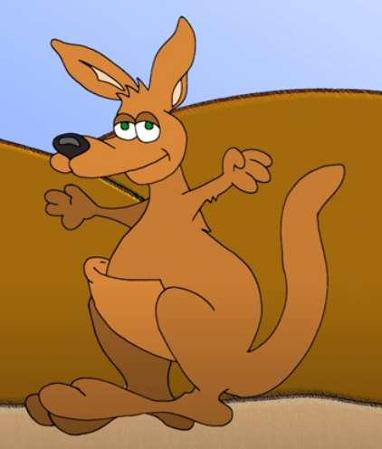
A KANGAROO
JUMP

Slide 3
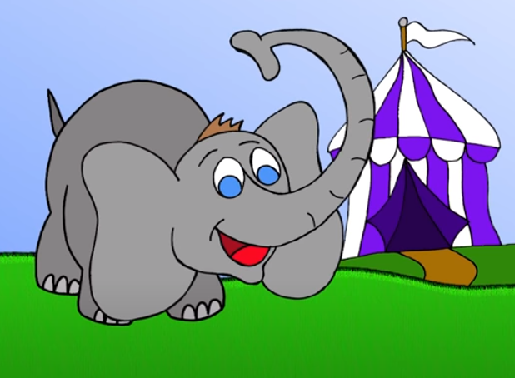
AN ELEPHANT
SWING

Slide 4
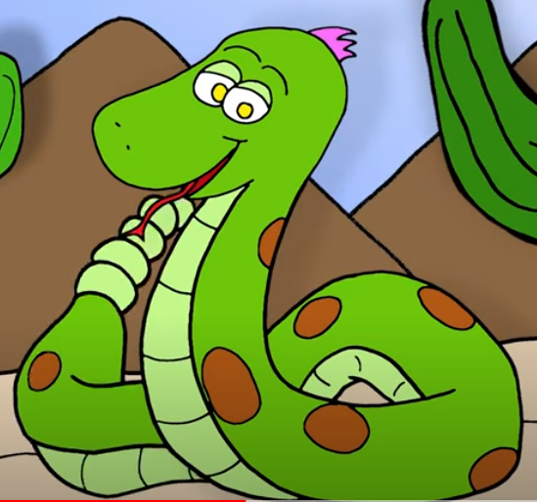
A SNAKE
SHAKE

Slide 5
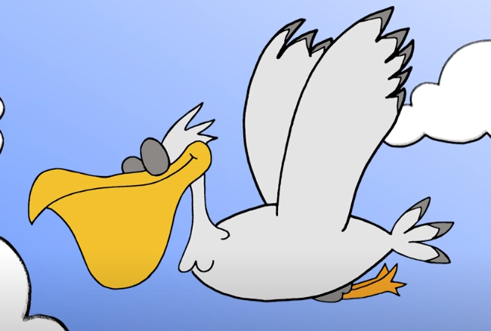
A PELICAN
FLY

Slide 6
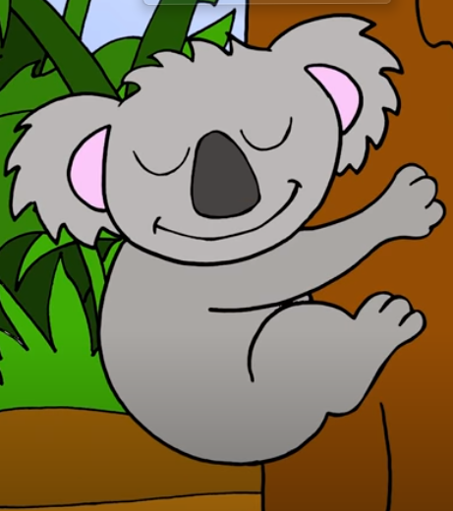
A KOALA
SLEEP

Slide 7
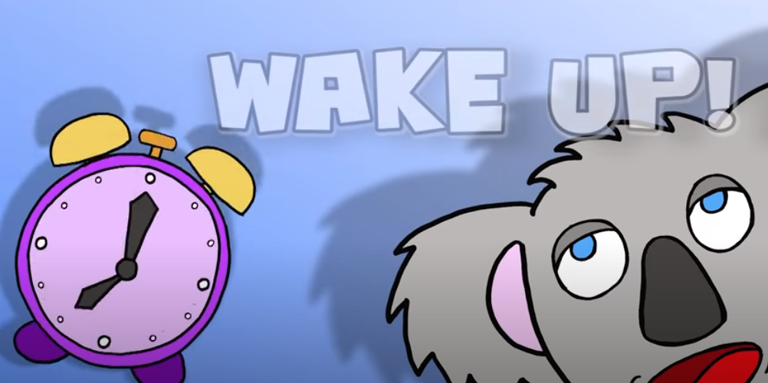
WAKE UP!

Slide 8
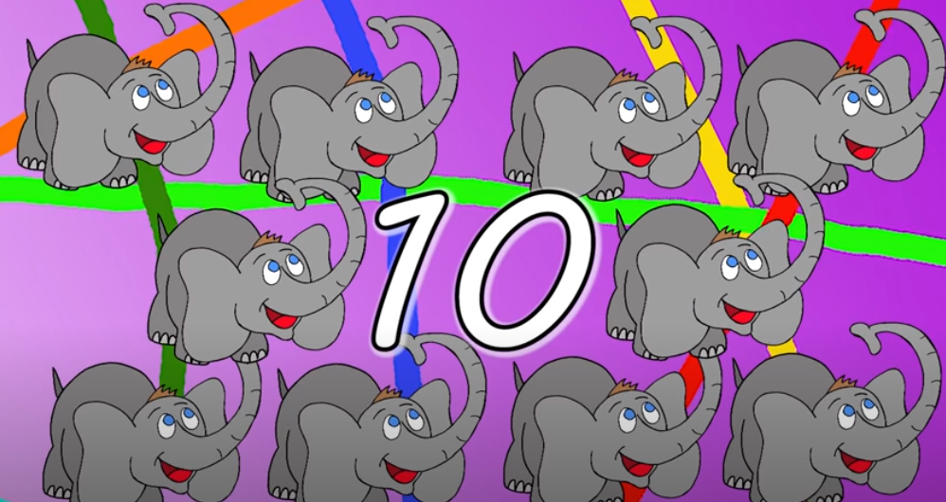
LET‘S COUNT

Slide 9
LIVEWORKSHEET

Slide 10
SEE YOU SOON!

